Slide 1






ACADEMY COURSE SYSTEM
Graduation Project
2023-2024

Slide 2






TEAM WORK
Yaseen Mohamed Kamal
Eslam Salah
Khalef
19-00514
Kareem Arafa
Hashem
Team Leader
19-00163
19-00263

Slide 3




TEAM WORK
Ahmed Mohamed Selem
Mohamed Salama Sayed
Yosef Mohamed
Tarek
19-00219
Omar Samy Anter
19-00078
19-00365
20-00072
SUPERVIED BY
DR: PROF. KHALED WASEF
ENG. SAFINAZ ALAA ELDIN

Slide 4
LIST OF CONTENTS
Abstract
Introduction
Problem Statement
Machine Learning
Related Work
Tools & Techniques
Front End
Back End
Conclusion

Slide 5



ABSTRACT
• E-learning has gained immense popularity and is considered one of the most widely adopted methods of education worldwide. It offers a flexible and convenient way to acquire knowledge and skills. The key components of an e-learning system are the course content, the platform for delivering the courses, and the ability to search for and enroll in desired courses.
• The goal of this system is to provide a seamless and efficient experience for users seeking to access and participate in e-learning courses. It aims to simplify the process of finding and enrolling in courses without requiring prior agreements between all participants. The project should allow users to register, search for existing courses, enroll in them, or even create new courses based on specific criteria.
• As an additional feature, utilizing machine learning techniques, the system can analyze user feedback and ratings to determine the proficiency level of each learner in a particular course. This ranking can help other learners identify the quality and suitability of a course based on the experiences of their peers.

Slide 6


INTRODUCTION
E-learning, also known as online learning or distance education, has revolutionized the way people acquire knowledge and skills. It offers a flexible and convenient alternative to traditional classroom-based education, allowing individuals to access educational resources and courses from anywhere in the world at their own pace. As the demand for e-learning continues to grow, there is a need for effective systems that can recommend suitable courses to learners based on their interests, preferences, and learning goals.
One of the key challenges in e-learning is the vast amount of available courses and educational resources. With such a wide range of options, learners often face difficulties in finding the most relevant and high-quality courses that align with their specific needs. This is where machine learning comes into play.

Slide 7

INTRODUCTION
Machine learning, a subfield of artificial intelligence, focuses on developing algorithms and models that can automatically learn and make predictions or decisions based on data. In the context of e-learning, machine learning techniques can be utilized to build intelligent course recommendation systems that assist learners in discovering the most suitable courses for their individual learning journeys.
The application has the power of artificial intelligence and machine learning, as through the user’s specifications and needs, the appropriate course will be suggested to him, through machine learning, understanding, and analyzing natural languages.

Slide 8
PROBLEM STATEMENT
There are many different specializations and courses available online, and it can be difficult to know which one is right for you. The team can help by providing a variety of features to help learners find appropriate content for their needs Even after finding a few courses that interest them, it can be difficult to compare them. A website can help by providing information about each course.
To make it easier to find courses, the site can use a search bar that allows learners to filter results by skill, subject, level, price, or other criteria. The site can also make recommendations based on the learner's interests and previous course history.

Slide 9

PROBLEM STATEMENT
To provide detailed information about courses, the site can include a detailed course outline, instructor bio, and price information for each course. The site can also include reviews from other learners to provide feedback on the course.
To make it easy to compare courses, the site can offer side-by-side comparisons of courses, or allow learners to rate and review courses. The site can also provide a list of courses that are similar to each other.

Slide 10
PROBLEM STATEMENT
Lack of interaction: Limited opportunities for interaction with instructors and peers can hinder the learning experience, especially for social learners.
Limited engagement: Traditional course formats with static content can lead to disengagement and low completion rates.
Personalized Learning Paths: Utilizing AI and user data, platforms can recommend relevant courses, learning materials, and study paths based on a learner's background, interests, and learning goals.
Adaptive Learning: The platform can adjust the difficulty and pace of learning materials based on a learner's performance, ensuring they are challenged appropriately.

Slide 11



RELATED WOEK
Udemy is a large online learning platform that offers a wide variety of courses on a vast range of topics.
leverages user browsing history, past course enrollments, ratings, and reviews to suggest relevant courses. It also uses collaborative filtering, recommending courses similar to those enjoyed by users with similar interests.
Focus on Online Courses: It's a marketplace where instructors can create and sell their own online courses. This allows for a diverse course library encompassing a multitude of subjects.
Paid and Free Courses: The platform offers both paid and free courses, catering to learners with different budgets and interests.
Self-Paced Learning: You can learn at your own pace, with on-demand course content accessible anytime, anywhere.
Course Variety: Udemy boasts over 183,000 video courses on topics like web development, data science, business, personal development, and pretty much anything else you can imagine.

Slide 12

RELATED WOEK
Coursera, similar to Udemy, is a popular online learning platform that provides a vast collection of courses.
employs AI to personalize course recommendations based on a user's educational background, work experience, and learning goals. They might also consider factors like a user's completion rates and performance in past courses.
Course Providers: Coursera partners with universities and other institutions like corporations to offer their courses online. This means you'll find courses from prestigious institutions like Stanford, Yale, and Google, alongside courses from industry leaders.
Course Focus: Coursera leans more towards academic-style courses, often with a structured curriculum, assignments, and graded assessments. While it does have some vocational courses, it has a stronger reputation for professional and academic development.

Slide 13




TOOLS
TECHNIQUES

Slide 14



MACHINE LEARNING

Slide 15
MACHINE LEARNING
Python is one of the most popular programming languages for machine learning due to its simplicity, flexibility, and extensive ecosystem of libraries and frameworks.
Libraries and Frameworks: Python offers several powerful libraries and frameworks specifically designed for machine learning. The most widely used is scikit-learn, which provides a comprehensive set of tools for data preprocessing, feature extraction, model selection, and evaluation. Additionally, TensorFlow and PyTorch are popular deep learning frameworks that enable the development and training of complex neural networks.
Data Manipulation and Analysis: Python's libraries, such as NumPy and Pandas, provide efficient data manipulation and analysis capabilities. NumPy provides support for multi-dimensional arrays and mathematical operations, while Pandas offers data structures like DataFrames for handling structured data, making it easier to preprocess and clean datasets.

Slide 16
CHAT BOT
A chatbot is a software application or program designed to interact with users through a conversational interface, typically in the form of text-based messages. It utilizes natural language processing (NLP) and artificial intelligence (AI) techniques to understand and respond to user queries or commands in a human-like manner. Chatbots can be found in various platforms such as websites, messaging apps, and voice assistants.
Chatbots are commonly used for a range of purposes, including customer support, information retrieval, task automation, and personal assistance. They can provide instant responses to frequently asked questions, assist with product recommendations, help with scheduling appointments, and perform various other tasks based on their programming and capabilities.
Some chatbots are rule-based, following predefined rules and responses, while others employ machine learning algorithms to learn from user interactions and improve their responses over time. Advanced chatbots may utilize natural language understanding (NLU) to comprehend user intents and context, allowing for more sophisticated and interactive conversations.

Slide 17
CHAT BOT
A chatbot designed to recommend courses is an invaluable tool for individuals seeking guidance and direction in their educational pursuits. This intelligent virtual assistant leverages advanced algorithms and machine learning techniques to understand user queries and provide personalized course recommendations. By analyzing the user's interests, past educational background, career aspirations, and preferred learning style, the chatbot generates tailored suggestions that align with the user's specific needs. Whether it's academic courses, professional development programs, or online tutorials, the chatbot considers factors such as relevance, reputation, and user reviews to curate a comprehensive list of recommended courses. This technology not only saves time and effort in searching for suitable courses but also facilitates continuous learning and skill development by offering a curated selection of educational opportunities. With its ability to adapt and evolve based on user feedback and preferences, the course recommendation chatbot serves as a knowledgeable and reliable virtual advisor, empowering individuals to make informed decisions and embark on a lifelong journey of learning and growth.

Slide 18
PYTHON
Python is a versatile and popular programming language known for its simplicity and readability. It is widely used for various purposes, including web development, data analysis, artificial intelligence, scientific computing, and more.
Here are some key points to consider for your Python :
1. Python Syntax: Provide an overview of the basic syntax and structure of Python code, including variables, data types, operators, control structures (if statements, loops), functions, and classes.
2. Built-in Data Structures: Explain Python's built-in data structures such as lists, tuples, dictionaries, and sets. Describe their properties, common operations, and best practices for their usage.
3. File Handling: Cover file input/output operations in Python, including reading from and writing to files. Explain different file modes, error handling, and working with file objects.

Slide 19
PYTHON
4. Modules and Packages: Describe the concept of modules and how they enable code reuse and organization. Explain how to import modules, create custom modules, and work with packages.
5. Exception Handling: Cover the basics of exception handling in Python, including try-except blocks, handling different types of exceptions, raising exceptions, and handling exceptions gracefully.
6. Object-Oriented Programming (OOP): Provide an introduction to OOP concepts in Python, such as classes, objects, inheritance, encapsulation, and polymorphism. Explain how to create and use classes, define attributes and methods, and implement inheritance.

Slide 20
PYTHON LIBRARIES USED IN PROJECT:
Sklearn:
Scikit-learn (often abbreviated as sklearn) is a powerful and popular Python library for machine learning. It provides a comprehensive set of tools and algorithms for various machine learning tasks, making it a valuable resource for data scientists and developers. Here's a breakdown of key aspects of scikit-learn:
Supervised Learning: Algorithms for tasks where you have labeled data and want to train a model to predict labels for new, unseen data. This includes classification (e.g., spam detection, image recognition) and regression (e.g., predicting house prices, stock prices).
Unsupervised Learning: Algorithms for analyzing and understanding unlabeled data, where you want to uncover hidden patterns or structures within the data. This includes clustering (e.g., grouping similar customers), dimensionality reduction (e.g., reducing complex data to a lower dimension for easier analysis).
Model Selection and Evaluation: Tools to help you choose the right machine learning model for your task and evaluate its performance on unseen data.

Slide 21
PYTHON LIBRARIES USED IN PROJECT:
googletrans:
The googletrans library is a Python library that allows you to translate text from one language to another using Google Translate's API. However, it's important to note that it interacts with the unofficial Google Translate API and not the official Google Cloud Translation API. Here's a breakdown of key points about googletrans:
Language Translation: It provides functions to translate text between various languages. You can specify the source and target languages using language codes (e.g., 'en' for English, 'es' for Spanish).
Language Detection: The library can also attempt to detect the source language of a text snippet if you're unsure.

Slide 22
PYTHON LIBRARIES USED IN PROJECT:
Pandas:
Pandas is a powerful and popular Python library specifically designed for data analysis and manipulation. It's built on top of NumPy, another essential library for scientific computing in Python, and provides high-performance, easy-to-use data structures and data analysis tools.
Data Cleaning: Tools to handle missing data, identify and remove outliers, and perform data formatting tasks.
Data Indexing and Selection: Powerful indexing and selection methods to access specific data subsets based on various criteria (e.g., rows, columns, labels).
Data Aggregation: Functions to calculate statistics, group data by specific criteria, and perform various aggregations (e.g., sum, mean, count).

Slide 23
PYTHON LIBRARIES USED IN PROJECT:
Flask:
Flask is a lightweight and versatile web application framework written in Python. It provides a minimalist foundation for building web applications, allowing developers to have more control over the application's architecture. Here's a breakdown of key aspects of Flask:
Microframework: Unlike Django, another popular Python web framework, Flask is a microframework. This means it offers a smaller core set of features and doesn't enforce a specific project structure. This gives developers more flexibility in building their applications.
Routing: Flask allows you to define routes that map URLs to specific Python functions (called views) that handle incoming requests. This is the core mechanism for handling user interactions within the web application.
Templating: Flask integrates with templating engines like Jinja2, which enable you to generate dynamic HTML content based on data passed from your Python code. This separation of concerns improves code maintainability.

Slide 24
FRONT
END

Slide 25
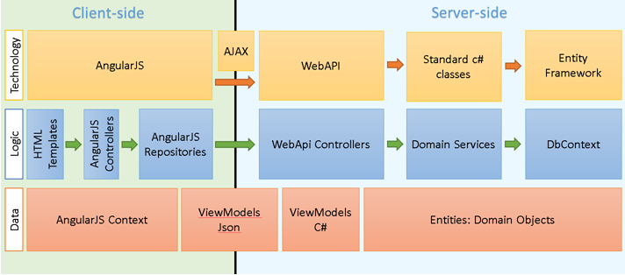
FRONT END
Angular is a popular open-source web application framework developed by Google. It is widely used for building dynamic and scalable single-page applications (SPAs) and is based on TypeScript, a statically-typed superset of JavaScript.
Angular, a powerful framework for building web applications, is used by a wide range of organizations to create dynamic and feature-rich user interfaces.

Slide 26



FRONT END
POPULAR APPLICATIONS BUILT WITH ANGULAR:
Gmail (Google): A free web-based email service developed by Google. It offers features for sending and receiving emails, managing contacts, organizing mailboxes, and integrating with other Google products.
Upwork: A freelance marketplace that connects businesses with freelance professionals (freelancers) across various skills and industries. It allows freelancers to find work, showcase their skills, and manage projects, while businesses can search for qualified talent and collaborate on projects.
YouTube (Google): An online video-sharing platform where users can upload, watch, and share videos. It offers a vast library of content across various categories, including music videos, educational tutorials, entertainment clips, and vlogs.

Slide 27
FRONT END
Here's an overview of Angular and its key features:
1.Architecture: Angular follows a component-based architecture, where the application is divided into reusable and modular components. These components encapsulate the HTML templates, CSS styles, and application logic, making it easier to develop and maintain complex applications.
2. TypeScript: Angular is built using TypeScript, which brings static typing, classes, interfaces, and other object-oriented programming features to JavaScript. TypeScript provides better tooling, compile-time error checking, and enhanced code maintainability.

Slide 28
FRONT END
Here's an overview of Angular and its key features:
3.Two-Way Data Binding: Angular offers powerful two-way data binding, allowing automatic synchronization of data between the model (component) and the view (template). Any changes in the model are reflected in the view, and vice versa, without requiring manual updates.
4. Dependency Injection: Angular has a built-in dependency injection (DI) system that helps manage the dependencies between components. DI promotes code reusability, testability, and modularity by enabling the injection of dependencies rather than instantiating them manually.

Slide 29
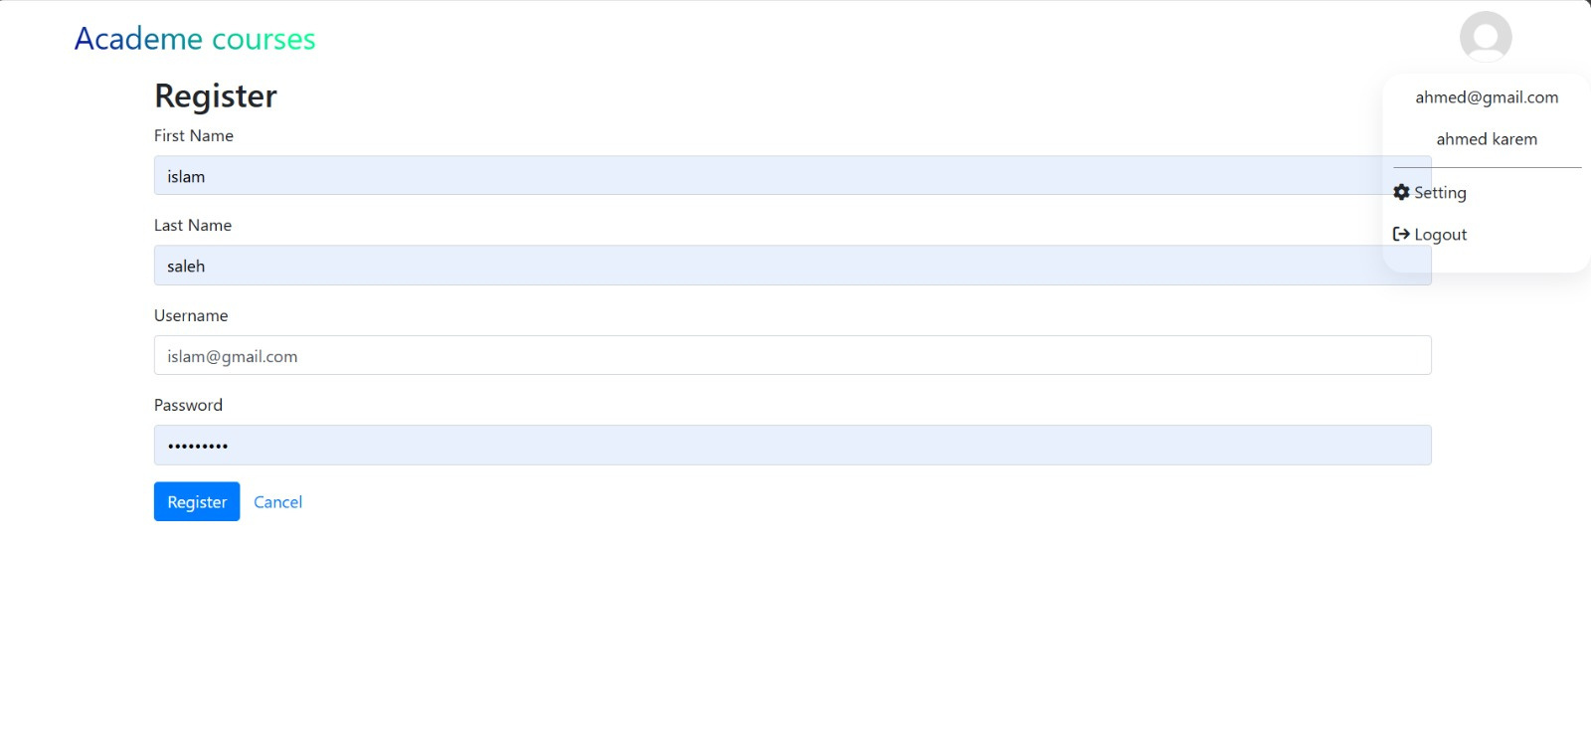
SCREEN SHOTS OF PROJECT

Slide 30
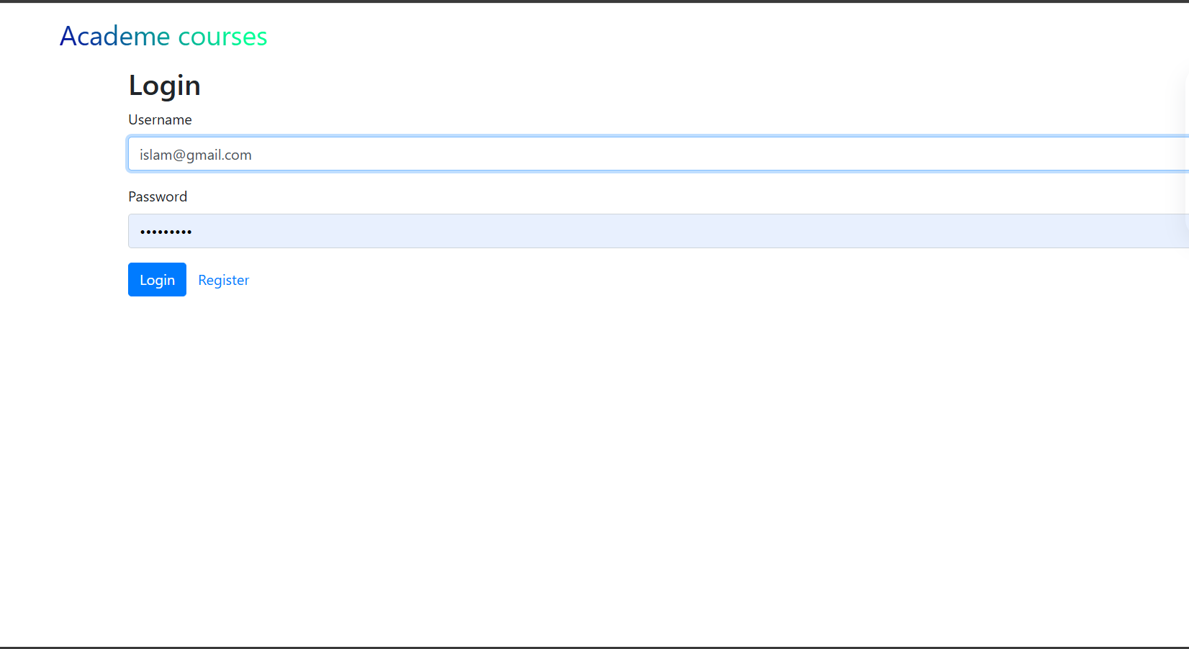

Slide 31

SCREEN SHOTS OF PROJECT

Slide 32
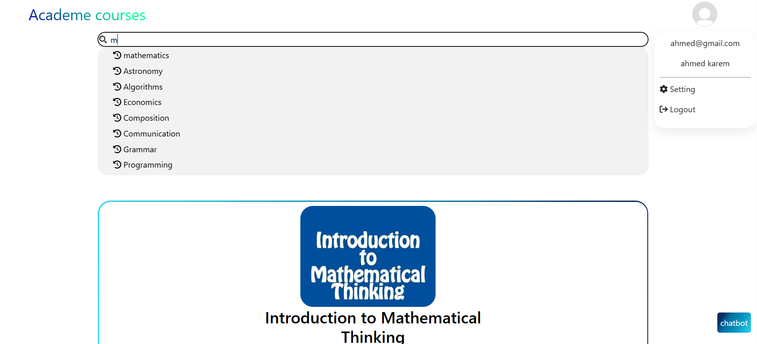
SCREEN SHOTS OF PROJECT

Slide 33
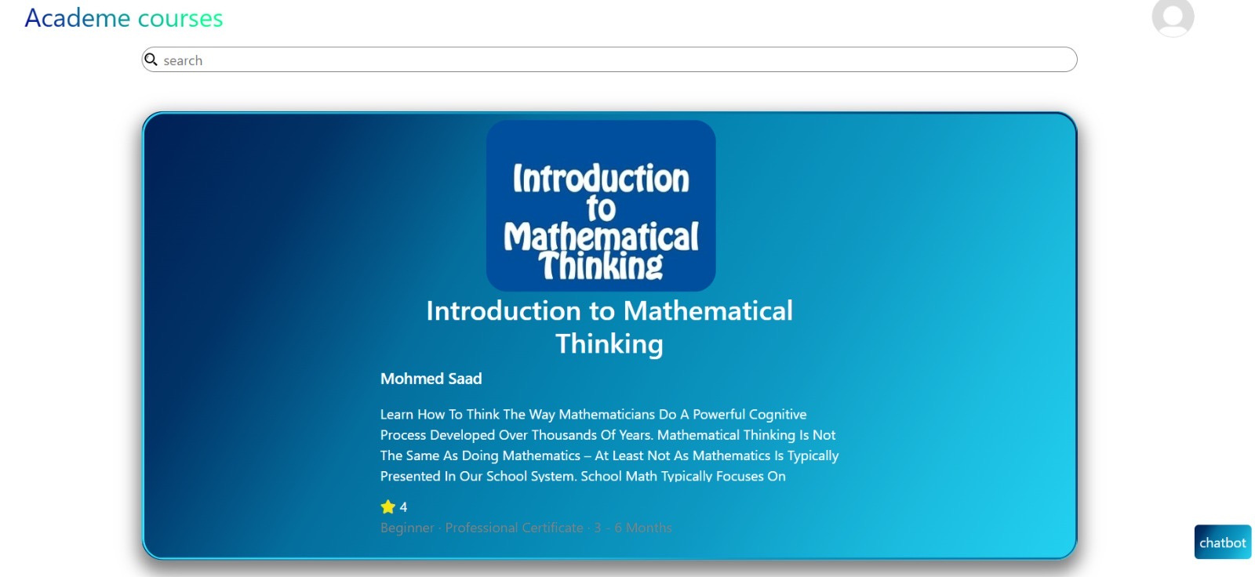
SCREEN SHOTS OF PROJECT

Slide 34
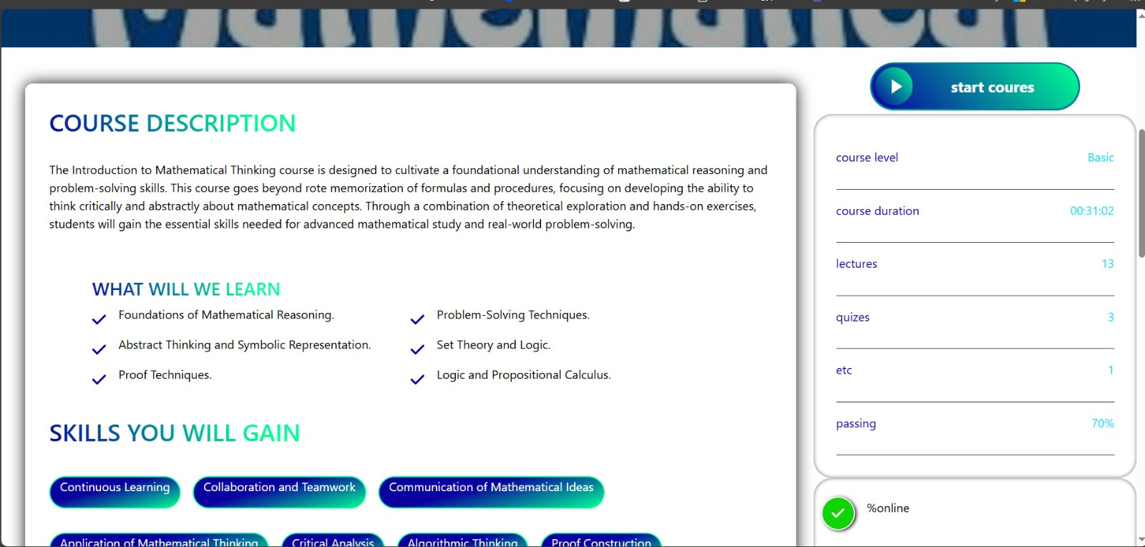
SCREEN SHOTS OF PROJECT

Slide 35
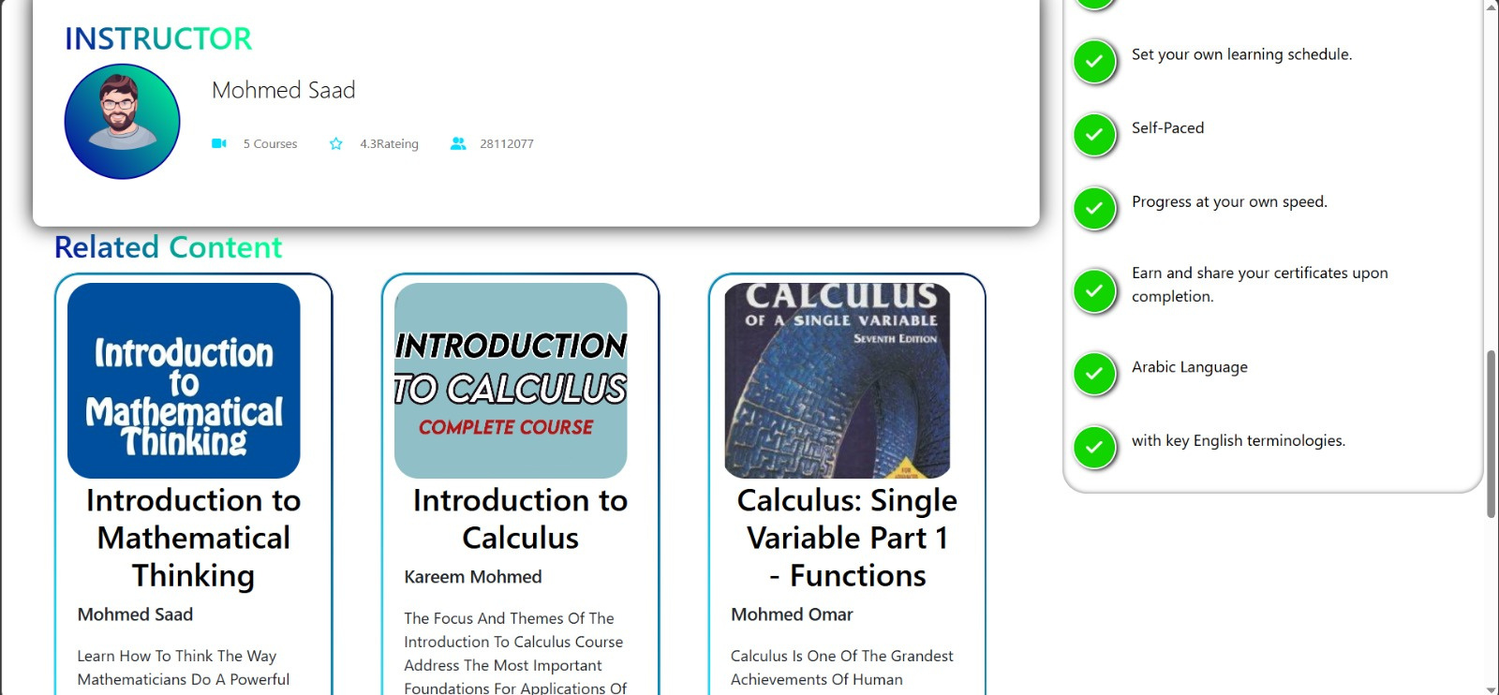
SCREEN SHOTS OF PROJECT

Slide 36
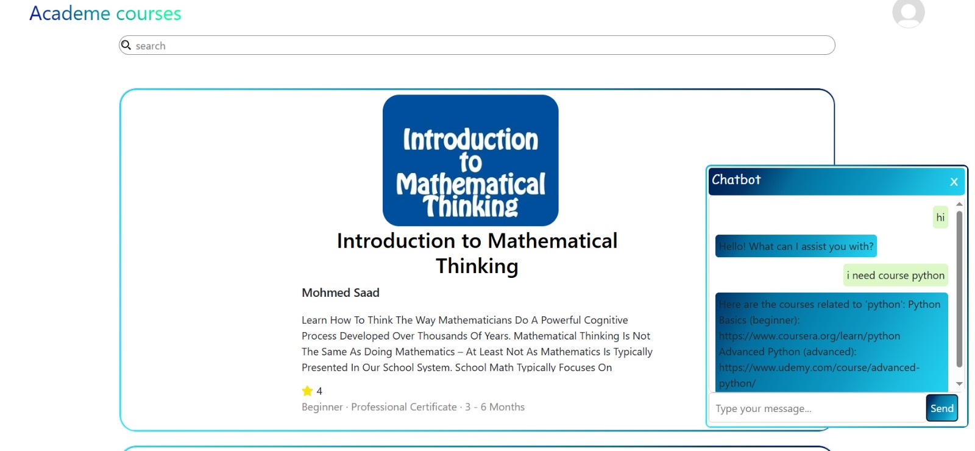
SCREEN SHOTS OF PROJECT

Slide 37
BACK
END

Slide 38
BACK END
WHAT IS BACK END?
The back-end of an application refers to the part of the application that isresponsible for processing data, managing businesslogic, and communicating with other systems or databases. It typically runs on a server and is responsible for handling requests from the front-end of the application (e.g., user interfaces, web browsers, or mobile devices). In a web application, the back-end is responsible for managing the server-side functionality, such as processing forms, handling database queries, and managing user authentication and authorization. It may also be responsible for managing APIs and other services that are used by the front-end of the application. The back-end of an application is often built using server-side programming languages and frameworks, such as ASP .NET, Java, Python, or PHP. It may also use databasesand other technologies to store and manage data.
Overall, the back-end is an essential part of an application, as it is responsible for managing the core functionality and data processing that makes the application work.

Slide 39
BACK END
NODE.JS
Node.js is an open-source, cross-platform JavaScript runtime environment that allows you to execute JavaScript code outside of a web browser. This means you can use JavaScript to build server-side applications, command-line tools, and more.
KEY FEATURES OF NODE.JS:
JavaScript Everywhere: Use JavaScript for both front-end and back-end development, offering a unified language across your application stack.
Event-Driven and Non-Blocking: Efficiently handles multiple concurrent requests without blocking, making it ideal for real-time applications.
Lightweight and Scalable: Node.js has a small footprint and scales well for applications handling high traffic.

Slide 40
BACK END
KEY FEATURES OF NODE.JS:
Faster Development: JavaScript skills can be readily applied to both front-end and back-end, potentially streamlining development.
Real-Time Applications: Node.js's event-driven architecture makes it perfect for building applications with real-time functionality like chat or data streaming.
Scalability and Performance: Node.js excels at handling high-traffic applications due to its non-blocking I/O model.
Large and Active Community: The extensive community provides support, libraries, and best practices for Node.js development.

Slide 41
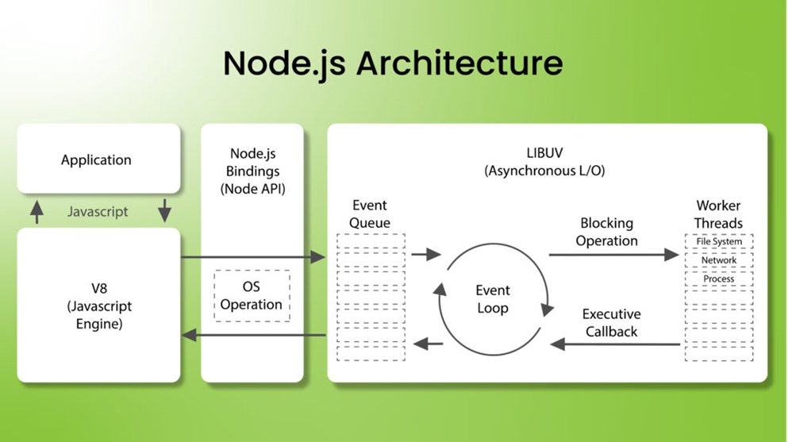
BACK END
NODE JS

Slide 42


OUR APPLICATION FEATURES
FACILITATING THE USER INTERFACE
FLEXIBILITY IN USE
NATURAL LANGUAGE UNDERSTANDING

Slide 43
CONCLUSION

Slide 44
CONCLUSION
FUTURE WORK
-There are some features we plan to add it in our System in the future like: -
1.Adding Arabic language to the application.
2.Add the possibility of electronic payment.
3.Operatingit in countries other than Egypt.

Slide 45
CONCLUSION
CONCLUSION
In the end, we would like to thank our professor, Professor Khaled Wasef, for his effort and effort with us, and the help Safinaz Alaa Eldin, for her cooperation with us. We were very honored to work on this project for me and my friends. We also hope that this project will be very useful for students and non-students and will help them learn and develop themselves and their lives. It was a useful experience for all of us, and we hope that we lived up to your good opinion of us. Thank you very much.

Slide 46


THANK YOU

